Slide 1
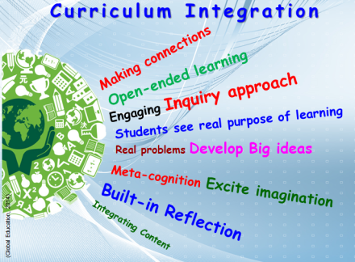
Curriculum Integration to Promote Student Outcomes
Toms River High School East
Presenter: Assistant Principal Mrs. Casey Daniel
Notes:
Today, we will be discussing the best practices to curriculum integration, and why these strategies support and promote positive student outcomes and student achievement. This presentation, along with articles and sample lessons will be posted to our staff professional development Google Classroom.

Slide 2


Objectives
Ideas to implement cross curricular instruction into the classroom.
How to successfully implement & connect subject matter through unifying concepts.
Cross curricular support through STEAM programs and LATIC Classrooms.
Infusing technology that supports the curriculum.
Eliminating bias and adding diversity to the classroom.
Raft assignments as instructional strategies.
Increase effectiveness of instruction for a common goal.
Notes:
Through this presentation, you will be presented with ideas and strategies to infuse in your classroom, which support cross curricular integration. In the next few years, the district will be rolling out new initiatives, such as more latic classrooms and additional chrome carts to support a technology infused curriculum. Through professional development workshops, PLC’s, and Professional Development incentives, the district will provide our students with a sound education, creating deep thinkers, and life-long learners.

Slide 3
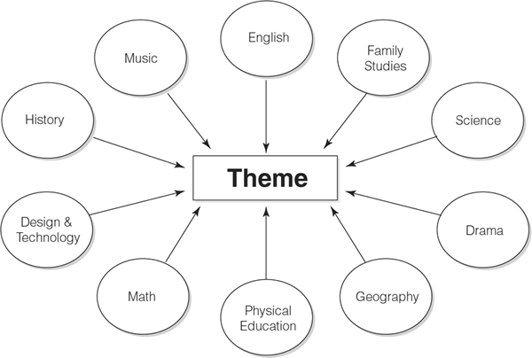
What is Curriculum Integration & Why it Works
If schools are linked with life, alive with activity methods, offering learning opportunities which concentrate on current themes with multimedia support from all agencies and many different contributors, attitudes and skills will be fostered which in after life will result in lifelong learning (Doyle, K., 2019).
Notes:
Curriculum integration incorporates an active learning environment, with learning opportunities for all learning styles. There is no one-size fits all with education, and as educators, we have the challenge of integrating concepts and themes that all students can connect with. Through our rigorous and technology infused curriculum, we will foster life-learners.

Slide 4

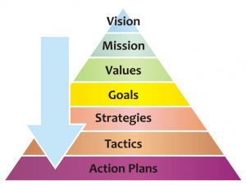
Mission & Goals
Grade 9 English
The Toms River Regional Schools curriculum creates the structure to help students master learning standards using a research-based approach that drives student inquiry, encourages creativity, and prepares students for college, careers, and life. Every course is driven by the belief that students need to acquire and expand critical thinking skills, and apply knowledge and skills to real world problems across a wide range of content areas. In addition to strong content, social-emotional elements like social awareness, self management, responsible decision making, relationship skills, independence, accountability, and motivation are built into each curriculum.
https://www.trschools.com/curriculum/docs/2019/09/Grade-9-English-Curriculum-2019_2020.pdf
Notes:
In reviewing the district mission and goals, our curriculum is structured to help students master, not only the learning standards, but the skills needed to be college & career ready. Through curriculum integration and a common goal, we as a district, a school, and as educators will support our students. (www.trschools.com) Let’s look at the Grade 9 English Curriculum, which was recently re-done with the support of secondary English supervisor, Mrs. Tonya Rivera, and the Grade 9 English teachers. After reviewing the Grade 9 curriculum, how does this support curriculum integration, and the common goals of the district?

Slide 5
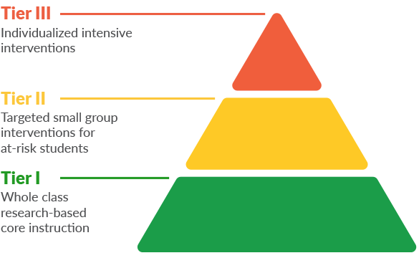
RTI
Supporting Differentiation
Response to Intervention (RTI)
Early identification and support of students with learning and behavior needs.
Notes:
Response to intervention (RTI) is a multi-tier approach to the early identification and support of students with learning and behavior needs (Gorski, D). Various instructors such as special education teachers, general education teachers, and specialists are included in RTI services. RTI is supported by: High-quality, scientifically based classroom instruction, ongoing student assessment, tiered instruction, and parent involvement. Through RTI, we can support students through different approaches, and infuse problem-solving, functional assessment, standard protocol, and hybrid approaches (Gorski, D). Moving into our October professional development day, staff members will be able to sign up for a professional development session to learn more about RTI.

Slide 6
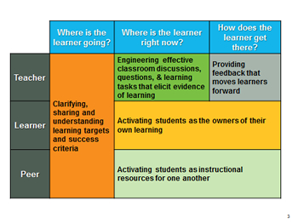

Technology that Supports Curriculum
Latic Classrooms
STEAM & Makerspace
Google Classroom
Student-Centered Lessons
Active Learning Environments
Digital Textbook Options
Ted Talks
Chromebooks accessibility
Notes:
“We expected the students to learn and to present new material and to acquire new technology skills that they could use in a setting that would make learning the skills a purposeful activity” (Kelley, D., Finley, R., Koehler, K., & Picard, K.,2001). In preparing our students for the future, we must utilize and infuse technology that supports the curriculum. We are preparing students for jobs that did not exist years ago. (Sorenson & Goldsmith, 2011). There are many opportunities available to our students, such as LATIC classrooms, STEAM programs, the utilization of Google Classroom, engaging options, such as student-centered lessons, thus creating active learning environments, digital textbook options, Ted talks, and over 20 chrome carts in each high school. Let’s break out into small groups for a few minutes and share out some ideas on what makes a successful active learning environment. Use the “active learning” visual for support.

Slide 7

STEAM & Latic
Developing a RAFT Assignment
What is it?
An instructional strategy designed to help students focus on writing and reasoning, while coming to understand ideas essential to the topics at hand.
R: Role A: Audience F: Format T: Topic
Benefits:
Choice*
Creativity
Variety
Purpose:
All students can explore and apply same essential knowledge, understanding and skills.
Emphasis on interest to individual students
Modes that work for individual students.
Science, Technology, Engineering, Art and Mathematics
Learner Active Technology-Infused Classroom
Notes:
The inclusion of art within the realm of STEM, thus creating STEAM as an interrelated and collaborative content community for solving problems; and a focus on the language, the lexicogrammatical structures of each discipline, and literacies of STEAM. The Arts provide alternate approaches to solving problems and brings more opportunities for collaborative processes within ‘transdisciplinary’ spaces Doyle, K. (2019). The Toms River Regional School District is proud to host three STEAM academies. Through these academies, students are exposed to curriculum integration on many different levels. Additionally, staff members are being trained on integration of LATIC classrooms. Another strategy in supporting a diverse learning community, is the development of RAFT assignments. RAFT assignments can be used in any academic course. (RAFT article provided by my Mentor Principal, Mr. Kevin McCann).

Slide 8

Teacher Collaboration
Collaboration among teachers can also generate new knowledge of what strategies or materials work well…(Lesaux, 2013).
Professional Learning Communities
Pineapple Charts
Informal & Voluntary
Everyday Lessons
Special Activities
Sharing & Learning Together
Notes:
It is truly difficult to find the time to collaborate. But...it IS important to find the time to collaborate with the teachers in your department and within the school. History and English teachers can collaborate on units connecting to World War II — in connection to the “Holocaust” unit. Music teachers and history teachers can collaborate to incorporate skills connecting to musical history. There is so much we can learn by using our greatest resource, which is the teacher down the hall. Teacher collaboration supports curriculum integration. Toms River High School East is proud to roll and and support a “Pineapple” chart incentive, so open up classrooms to teachers for informal walkthroughs to see what amazing things our peers are doing. Would anyone like to share an experience from the new Pineapple Chart Incentive?

Slide 9
Sample Lessons
Interdisciplinary Connections: History & Current Events in the Media.
Technology Integration: Internet Clips of Famous Speeches
Goals & Objectives: After reading chapter two of The Language of Composition, SWBAT write terms, key phrases, and concepts from “Close Reading”: “The Art and Craft of Analysis” on the board to develop a word splash, which serves as the basis for class discussion.
Learning Activities & Instructional Strategies:
Do Now
Class discussion round-robin fashion
Reread & Listen to Queen Elizabeth’s “Speech to the Troops at Tillbury” & Winston Churchill's, “Blood, Toil, Tears, and Sweat”.
Close Reading: The Art & Craft of Analysis
Standards: 11-12.RI.01 11-12. RI.02 11-12. RI.04
11-12. RI05
11-12. RI07
21st Century Themes: Global Awareness & Civic Literacy
21st Century Skills: Critical thinking & Problem solving Communication & Collaboration Information and Media Literacy
Notes:
Here is a sample lesson and plan from AP teacher, Mrs. Rachel Hay: Please note the 21st century themes, 21st century skills, technology integration, and interdisciplinary connections. This is a perfect lesson to support the main objectives of this workshop today — curriculum integration.

Slide 10
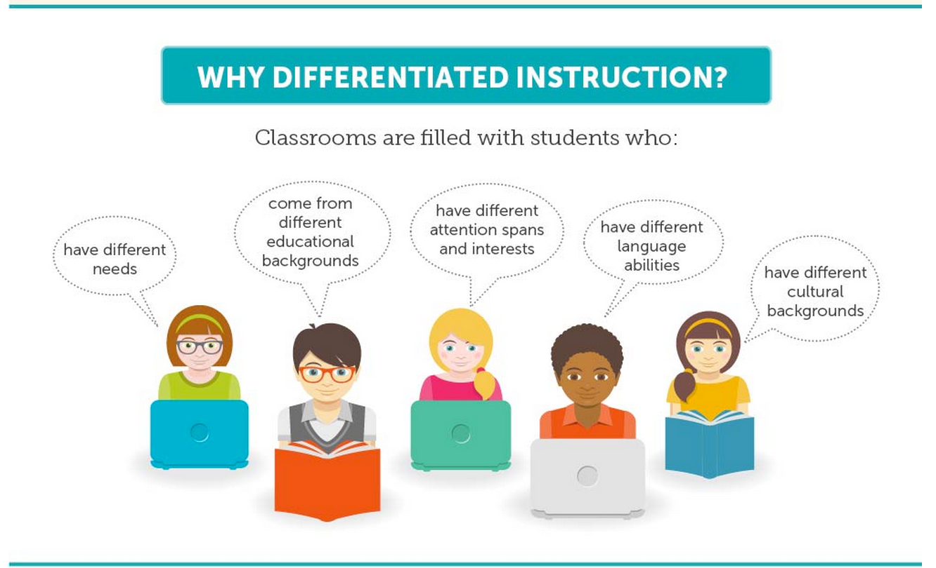
Sample Lesson Continued:
Differentiation:
Students will work individually, collaborate, move around the room, reread text, listen to audio, and use colors and graphic organizers as they work so that the lessons appeal to the variety of learners and learning styles.
Assessments:
Students will earn grades for their completion of the close reading organizers based upon the rubric provided.
Homework: Students will write the cereal analysis with a partner and submit to Google Classroom by Wednesday.
Notes:
Please note the differentiation in this lesson, along with the various “types” of assessments. Could you improve this lesson in anyway? Let’s have small break out groups and share sample lessons that we brought with us today to support curriculum integration.

Slide 11
Sample Lessons
Interdisciplinary Connections: History
Goals & Objectives:
Based upon their understanding of rhetorical devices employed in chapter one, SWBAT read and listen to various sets of music lyrics throughout the period and analyze them knowing SOAPSTone, rhetorical appeals, techniques and devices, and then sharing their responses with the class.
Learning Activities & Instructional Strategies:
Do Now
Students will read and listen to the music lyrics in the packet provided.
Students will work in pairs to exchange their analysis of the rhetorical devices and appeals.
Closure: How do you feel about your ability to analyze a written and visual text? Do you need more practice in any area
Music Lyric Analysis for An Introduction to Rhetoric
Standards: 11-12.RI.01 11-12. RI.02 11-12. RI.04
11-12. RI05
11-12. RI07
21st Century Themes: Global Awareness
21st Century Skills: Critical thinking & Problem solving Information Literacy Media Literacy
Notes:
Here is a another sample lesson and plan — Please note the 21st century themes, 21st century skills, technology integration, and interdisciplinary connections. This is another example of a lesson to support the main objectives of this workshop today — curriculum integration.

Slide 12
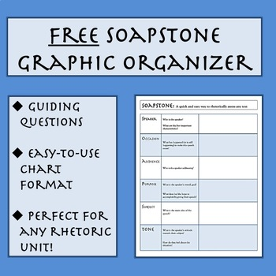
Sample Lesson Continued:
Differentiation:
Students will work and pair up at their individual pace as they finish listening and reading.
Assessments:
Students will earn grades based upon the test tomorrow.
At Home: Students will locate and analyze their own set of lyrics at home and write about their rhetorical analysis using a graphic organizer or a mind map format.
Notes:
Please note the differentiation in this lesson, along with the various “types” of assessments. Could you improve this lesson in anyway? Let’s have small break out groups and share sample lessons that we brought with us today to support curriculum integration.

Slide 13

Thank you!
Before logging out of your Chromebooks, complete the Google survey regarding today’s workshop
We are TRE
Tolerance
Respect
Excellence
Notes:
Thank you for your time and attention today. Toms River High School East is on the right path to fostering a love of education, and creating lifelong learners through our technology integration and professional development. Through this productive sessions, we can discuss and improve upon our already engaging and rigorous curriculum, by sharing lesson ideas, and supporting staff members.

Slide 14
References
Doyle, K. (2019). The languages and literacies of the STEAM content areas. Literacy Learning: The Middle Years, 27(1), 38–50. Retrieved from https://search-ebscohost-com.lopes.idm.oclc.org/login.aspx?direct=true&db=ehh&AN=133954204&site=ehost-live&scope=site
Gorski, D. (n.d.). What is RTI? Retrieved from http://www.rtinetwork.org/learn/what/whatisrti.
King, E. (1979). School Curriculum in the Context of Lifelong Education/Curriculum Integration and Lifelong Education (Book Review). European Journal of Education, 14(4), 369. https://doi-org.lopes.idm.oclc.org/10.2307/1503288
Lesaux, N. K. 1. nonie_lesaux@gse. harvard. ed., Burkhauser, M. A. ., & Kelley, J. G. . (2013). SUPPORTING Teachers. Principal Leadership, 14(2), 40–44. Retrieved from https://search-ebscohost-com.lopes.idm.oclc.org/login.aspx?direct=true&db=ofs&AN=90639445&site=ehost-live&scope=site
Kelley, D., Finley, R., Koehler, K., & Picard, K. (2001). Equal Access: Integrating Technology Into the Elementary and Secondary Curriculum. Re:View, 33(2), 63. Retrieved from https://search-ebscohost-com.lopes.idm.oclc.org/login.aspx?direct=true&db=ehh&AN=5128980&site=ehost-live&scope=site
Sorenson, R. D., Goldsmith, L. M., Méndez Zulma Y., & Maxwell, K. T. (2011). The principals guide to curriculum leadership. Thousand Oaks, CA: Corwin Press.
Notes:
Listed on reference slide is research and support used for this presentation!

