Slide 1

Toms River Regional Schools
Proposed Budget 2019-2020
Principal Mrs. Casey Daniel
Grand Canyon University
Education Finance
June 27, 2019
Toms River Regional Schools Budget 2019-2020 1
Notes:
Toms River Regional Schools hesitantly adopted the 2019-2020 school budget, with perceived budget cuts from the state. If state aid is not restored, the district stands to cut 400 staff positions in the next six year, beginning this year with cuts of several important staff positions, particularly in the kindergarten program. Additionally, sports programs will be cut, bus services removed, and program funding will be cut by 10%. Full day kindergarten will also be removed. With the recently-signed legislation, P.L. 2018, Chapter 67, otherwise known as S2, our district is required to raise taxes every year, while we cumulatively lose more than $80 million in school aid over the next six years. This means that dramatic budget cuts will have to be made each and every year over that six-year term. The district will be decimated if something does not change with regards to the allocation of school aid. Before budget cuts, the district was already operating 30 million dollars under adequacy. According to data, Toms River Regional Schools is among the most efficient and fiscally responsible district in the state, boasting the second-lowest total cost per-pupil spending and 8th lowest administrative cost in NJ. In addition, for the fourth year in a row we have been awarded the prestigious Certificate of Excellence in Financial Reporting by the Association of School Business Officials International. (All information provided from the Toms River Regional Schools Website: Trschools.com).
We have also—on behalf of nearby districts and those affected throughout the state

Slide 2
District Goals & Budget Goals 2019-2020
Unlike the perfunctory and generic goals developed by many districts, the five 2019-2020 district goals developed by the Toms River Regional School District Board of Education represent high aspirations, with considerations of the increasing challenge of funding issues.
We will develop a financial plan to continue supporting our educational program that considers losses in funding and alternative revenue sources.
The district will continue to assess personnel assignments, class sizes, and department efficiencies in order to allocate staff in the most educational, organizational, and fiscally sound manner.
Toms River Regional Schools Budget 2019-2020 2
Notes:
The district has made great strides to align and connect our goals with the district budget. Toms River Schools has always been innovative in creating additional sources of revenue, and will continue to do so in the wake of the impending budget cuts. Moving forward, the district will continue to align the budget with the goals, mission, and values of the school, making the best decisions for the students.

Slide 3
2019-2020 Budget — Calendar
September/October 2018: Central data gathering process
October/November 2018: School and budget information presented to administration
November 2018/February 2019: Evaluation of the district budget and evaluation of proposals from supervisors and administration
February/March 2019: Finalize tentative budget subsequent to receiving state aid numbers.
March/May 2019: Meetings with the Board and Community Budget Advisory Committee regarding the budget.
May 2019: Deadline to approve final budget May 14, 2019.
Toms River Regional Schools Budget 2019-2020 3
Notes:
As is the standard procedure, we are in the finalizing steps of the budget. The district is still hopeful to restore state aid, and not have to cut positions within the district.

Slide 4
Proposed Budget 2019-2020 Staff
Budget Category | Account | 2017-18 Actual | 2018-19 Actual | 2019-20 Proposed
Regular Programs: Instruction | 11-1xx-100-xxx | $68,223,201 | $70,458,543 | $68,178,990
Special Education: Instruction | 11-2xx-100-xxx | $20,540,591 | $22,688,709 | $23,753,318
Basic Skills/Remedial: Instruction | 11-230-100-xxx | $772,342 | $788,955 | $844,465
Technology* 10% cut | 11-000-252-xxx | $1,524,495 | $1,713,889 | $1,619,660
Toms River Regional Schools Budget 2019-2020 4
Notes:
In reviewing the data from previous budgets and the proposed budget for the 2019-2020 school year, the district has maintained a balance from 2017-2018, and is actually lower than in 2018-2019. Student enrollment is lower, therefore moving staff positions to different areas/levels rather than making cuts is essential. Due to retirements in the third grade elementary school at Cedar Grove Elementary, the kindergarten teacher will be moved to third grade, rather than rifted from their teaching position. The original amount of staff positions to be eliminated was 77 across the entire district, with the retirees, the number is 32. The district is eliminating attendance secretaries and one secretary in each guidance department. The kindergarten teacher will not be rifted, as cuts were made elsewhere. This teacher will be moved to the third grade position of the retiree.

Slide 5
Data Evidence & Projected Student Enrollment
Pupil Enrollment Categories | 10-13-2017 Actual | 10-15-2018 Actual | 10-15-2019 Estimate
On Roll Regular Full Time | 12,997.0 | 12,741.0 | 12,729.0
On Roll Regular Shared Time | 214.0 | 205.0 | 205.0
On Roll Special Ed Full Time | 2, 237. 0 | 2, 310.0 | 2, 310.0
On Roll Subtotal | 15, 561.0 | 15,368.0 | 15,356.0
Toms River Regional Schools Budget 2019-2020 5
Notes:
Student enrollment dropped last year, but is similar in the projected school year. With retirements, we do not need to rift too many staff positions. The initial amount of positions to be eliminated was 77, but as previously stated, with the retirements, the district was able to reduce that amount down to 32. The district will continue to fight to restore state aid.

Slide 6
Per Pupil Cost
Data and Projections
Per Pupil Cost Calculations | 2016-17 Actual Costs | 2017-18 Actual Costs | 2018-19 Revised Budget | 2019-2020 Proposed
Total Budgetary Per Pupil Cost | $12,701 | $13,235 | $13,832 | $13, 611
Total Classroom Instruction | $7,854 | $8,244 | $8, 525 | $8, 424
Classroom Salaries and Benefits | $7, 236 | $7, 772 | $7, 812 | $7, 720
Toms River Regional Schools Budget 2019-2020 6
Notes:
In comparison to other districts, Toms River Regional Schools has a low cost per pupil. This has been documented and reported by major sources and outlets, showing that the district is fiscally responsible and is operating under adequacy.

Slide 7
District Goals and Innovative Ideas
The district will increase its partnerships with external resources; improve and expand communication and outreach; and increase the number and diversity of activities that benefit the entire community.
Communications were improved through a complete renovation of the district website, increase in community events, and the replacement and upgrade of the phone system. The district had a much higher positive visibility in the media and was a leader in advocating for state funding.
Toms River Regional Schools Budget 2019-2020 7
Notes:
Toms River Schools has always been innovative in creating additional sources of revenue. Due to the impending budget cuts, the district must continue to be innovative in creating additional sources of income. Involving all stakeholders in the best interests of the students is essential moving forward as the budget is developed. The community truly came together during the 2018-2019 school year and had a higher visibility in media, social media, and outreach to parents and stakeholders. The district has created partnerships and sponsorships with local businesses and community members to support the needs of the schools and the students.

Slide 8
School Improvement Initiatives & Community Outreach
RWJBarnabas Health was not only a sponsor but a partner for our high school Career Academies.
The Greater Toms River Chamber of Commerce named the district its Organization of the Year.
Involved dozens of partners in successful grant applications and implementations, including the 3rd year of the NEA Big Read.
47 press releases were generated and over 60 positive articles published on TR by print and online media outlets.
Toms River Regional Schools Budget 2019-2020 8
Notes:
Toms River Schools will continue to work with the community to create sponsorships and partnerships to create additional sources of income to offset the projected budget cuts. Additionally, through these partnerships and sponsorships, the district can continue to give resources to staff and students to support the educational purpose and mission.

Slide 9
Technology & the Budget
Application of technology will enable more personalized, cross-curricular, and problem-based student learning at all levels.
Technology will improve district productivity and communication cost effectively through new platforms and systems
Technology is a key component of LATIC.
Toms River Regional Schools Budget 2019-2020 9
Notes:
The technology budget was cut by 10% for the upcoming year. Although the budget program was cut by 10%, the district is still moving forward with implementation of technology and use of Chromebooks. District supervisors are using portions of their approved budgets to purchase additional technology and create small working stations in classrooms, thus enhancing the technology and differentiated instruction. Building supervisors, such as the English supervisor for the high school level, determined that purchasing classroom libraries and less textbooks would also support the budget, and not hinder resources, as the online component and printing costs are cheaper than the purchase of textbooks.

Slide 10
Data of Technology Budget Information
Expenses | Budget Account Code | 2018-2019 | 2019-2020 Base Budget “proposed” | $$ Change vs. Revised | % Change vs. Revised
Instruction | 11-1xx-100-xxx | $1,939,775 | $1730,075 | ($209,700) | -10.8%
Technology | 11-000-252-xxx | $1,624,365 | $1619,510 | ($4,855) | -0.3%
Capital Outlay |  | $10,000 |  | ($10,000) | -100%
Toms River Regional Schools Budget 2019-2020 10
Notes:
The technology budget for the 2019-2020 school year has been cut by 10 percent. This helps to offset budget cuts from the state. The district has implemented a series of grants and sponsorships to purchase chromebooks and additional sources of technology.

Slide 11
Technology & the Budget
Staff continued to be trained in how to use technology to personalize learning.
The district participated in state and national initiatives like NJ Makers Day and Future Ready Schools.
Spaces were renovated using grants with technology at their core. The use of several digital tools was increased that foster the personalization of cross-curricular learning, like the Google Suite, Apex, and Performance Matters.
Toms River Regional Schools Budget 2019-2020 11
Notes:
The district will continue to use Google as a resource. All email is used through Gmail, along with teachers utilizing Google Classroom, among other technology resources. Through grants, the district is able to move forward with their technology initiative despite the 10% budget cut to technology.

Slide 12
Revenues
General Fund | 2018-2019 Revised Budget | 2019-2020 Base budget Proposed | $ Change vs. Revised | % Change vs. Revised
Local Property Taxes | $155,329,012 | $158,444, 292 | $3,115,280 | 2%
Medicaid reimbursement | $290,578 | $340,985 | $50,407 | 17.3%
State Aid-other | $850,00 | $950,000 | $100,000 | 11.8%
Special Education Aid | $9,865,327 | $9,865,327 | - | -
Equalization Aid | $39,941,537 | $39,941,537 | - | -
Toms River Regional Schools Budget 2019-2020 12
Notes:
The majority of the Toms River Regional School District’s budget comes from taxpayers. There was a small 2% increase in property taxes for the coming year. This will help to offset the 3.3 million dollar budget cuts from Governor Sweeney and the State of New Jersey.

Slide 13
Revenues Continued: Effects of the Budget Cuts
General Fund | 2018-2019 Revised Budget | 2019-2020 Base budget Proposed | $ Change vs. Revised | % Change vs. Revised
Categorical Special Education Aid | $2,538,055 | $2,538,055 | - | -
Adjustment Aid | $8,181,292 | $5,400,794 | ($2,780,498) | -34%
Categorial Transportation Aid | $5, 458, 073 | $5, 458, 073 | - | -
Subtotal State-Aid Formula | $$65, 984, 284 | $63, 203, 786 | ($2,780, 498) | -4.2%
Sub-Total, General Fund | $229,739,987 | $228,826,628 | ($913,359) | -0.4%
Toms River Regional Schools Budget 2019-2020 13
Notes:
Through the data provided in the last two slides, Toms River Regional Schools is adjusting state aid in the wake of the impending budget cuts. To summarize, the district reduced technology costs by 10 percent, and is able to create a working budget with the anticipated 3 percent cuts for the 2019-2020 school year.

Slide 14

District Goals
2019-2020
These projects stem from the district's larger mission of "creating a safe and positive learning environment where children can develop the confidence and capabilities to face the challenges of our rapidly changing world.”
Toms River Regional Schools Budget 2019-2020 14
Notes:
The district will continue the fight to restore state aid. The community of Toms River is united and strong. All decisions in regard to the budget are with the best interests of the students and their right to the best education possible. In eliminating staff positions throughout the district, the goal was to eliminate positions that did not directly impact student instruction and education. The goal of Toms River Schools is to create confident and capable young adults.

Slide 15
Referendum
Expectations 2019-2020
safety and security upgrades
improving accessibility through the Americans with Disabilities Act (ADA)
heating, ventilation, and air conditioning (HVAC) units and controls
door and window replacements
renovating and upgrading high wear and high use areas like science labs and playgrounds, with updated safety standards
repair and repaving of parking lots and driveways
Toms River Regional Schools Budget 2019-2020 15
Notes:
The community of Toms River passed the referendum to update the buildings in the district. All referendum projects will benefit students, staff, and the learning environment of the district. Over the past few years, a substantial amount has been removed from the capital reserve, therefore the passing of the referendum is essential to maintaining the buildings and structures in the district. The district has not gone out for a referendum in over 10 years, and it is essential to some of the older structures in the district. Despite impending budget cuts, the passing of the referendum, boosts morale within the district.

Slide 16
Moving Forward
S.O.S. - Save Our Schools
Toms River Schools will continue to aggressively fight for restoration of state aid.
Toms River Schools will adjust the budget accordingly communicating with the community.
Toms River Schools will actively participate in district wide-initiatives to promote additional sources of income.
Toms River Regional Schools Budget 2019-2020 16
Notes:
Toms River Regional Schools is a strong community. The community survived Superstorm Sandy and will survive the impending budget cuts. Through a strong culture, and support from all stakeholders, the district will prevail. As building principal, we cannot give up the fight to restore state aid - We will continue to aggressively fight to restore state aid, we will continue to create a budget that benefits students, and we will actively continue to create additional sources of revenue, such as grants, sponsorships, and partnerships.

Slide 17
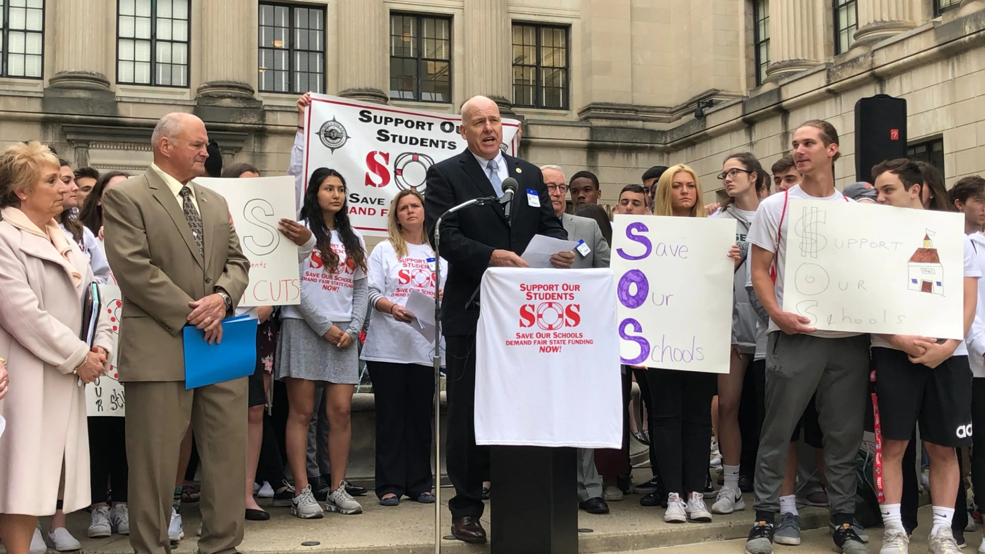

Moving Forward S.O.S. - Save Our Schools
Toms River Regional Schools Budget 2019-2020 17
Notes:
Toms River Schools will move forward into the 2019-2020 school year with optimism and strong leadership. We will prevail - Toms River Schools always comes out on top, and with the support of the community, we will continue our educational excellence and success.

Slide 18
References and Sources
Toms River Regional Schools Website: Trschools.com
Mr. Patrick Thomas: Principal of Toms River High School East
Mr. Bill Doerring: Toms River Regional School District Business Administrator
Ms. Megan Osborn: Human Resources Secretary for Toms River Regional Schools.
Toms River Regional Schools Budget 2019-2020 18
Notes:
Toms River Schools will move forward into the 2019-2020 school year with optimism and strong leadership. We will prevail - Toms River Schools always comes out on top, and with the support of the community, we will continue our educational excellence and success.

